Slide 1
19CSE313 – Principles of Programming Languages
Programming Paradigms

Slide 2
Introduction
While solving a simple problem or writing a program, we often say “If I had more time, I would have written a simpler program”
The reason is, that we made a program with greater complexity
The less complexity we have, the easier it is to debug and understand
The more complex a program becomes, the harder it is to work on it
Managing complexity is a programmer’s main concern
There are many general approaches that reduce complexity in a program or make it more manageable
One of the main approaches is the Programming Paradigm

Slide 3
Programming paradigm
Paradigm: A pattern or model
Programming Paradigm: A Pattern or model of Programming
A fundamental Style of Computer Programming
It does not refer to a specific language, but rather it refers to the way you program
There are lots of programming languages that are well-known but all of them need to follow some strategy when they are implemented, and that strategy is a paradigm

Slide 4
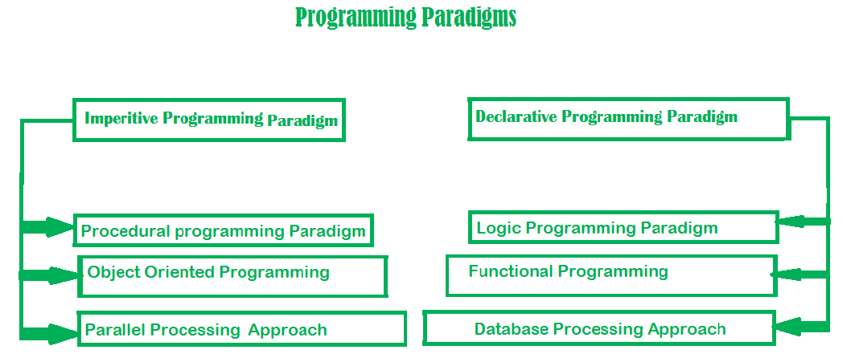
Types of programming paradigms
The fundamental approaches or styles of programming that dictate how you design, structure, and organize code to solve problems

Slide 5
Imperative paradigm
One of the oldest programming paradigm
focuses on describing a sequence of steps or commands (assignments and control flow constructs) that the computer must follow to accomplish a specific task or solve a problem
Works by changing the program state step by step through assignment statements
Consists of a set of commands for the computer to perform.
Describes how the inputs are given and outputs are obtained
Example: C, C++, Pascal, Fortran, Java, Python, Ruby, etc.
Advantage | Disadvantage
Simple to implement | Complex problems are difficult to implement
Contains loops, variables etc. | Less efficient and less productive

Slide 6
Procedural programming paradigm
Emphasizes on procedure in terms of underlying machine model
Organizes & structures code using procedures
A program is divided into a series of well-defined procedures or functions, each of which performs a specific task or operation
Procedures call each other and pass data between them
Has the ability to reuse the code
Example: C,C++, Java

Slide 7
Object oriented programming
Program is written as a collection of classes and objects which are meant for communication
Organizes and structures code around ‘objects’
The smallest and basic entity is an object and all kinds of computation is performed on the objects only.
More emphasis is on data rather than procedure.
Organizes code into objects, which are instances of classes that encapsulate data and behavior
Can handle almost all kinds of real-life problems
Advantages: Data Security, Inheritance, Code Reusability, Abstraction and Flexibility
Example: C++, Java, Python, Ruby etc.

Slide 8
Parallel processing approach
Processing of program instructions by dividing them among multiple processors
Focuses on the execution of multiple tasks or processes simultaneously, often with the goal of improving performance, efficiency, and responsiveness in computing systems → Lesser Execution Time
multiple threads or processes work together to solve a problem or perform a task concurrently
Divide and Conquer based approach
Key Characteristics: Concurrency, Independence, Parallelism Models, Synchronization, Load Balancing, and Parallel Hardware
Example: Java

Slide 9
Declarative paradigm
Style of building programs that expresses the logic of a computation without talking about its control flow
Often considers programs as theories of some logic
You declare the desired result or state, and the programming language or system is responsible for figuring out the necessary steps and operations to reach that result
Focus is on what needs to be done rather than how it should be done
Imperative (how to do) and declarative (what to do)
Categorised as Logic, Functional and Database

Slide 10
Logic programming paradigm
An abstract model of computation - centered around formal logic and symbolic reasoning
To solve logical problems like puzzles, series, etc -well-suited for problems involving knowledge representation, expert systems, and artificial intelligence
Main emphasis is on the knowledge base and the problem - Program execution is like the proof of a mathematical statement.
You specify a set of facts and rules in a declarative manner, and the computer or inference engine derives conclusions or answers by applying logical reasoning to these facts and rules
Example: Prolog
sum of two numbers in prolog:
predicates
sumoftwonumber(integer, integer)
clauses
sum(0, 0).
sum(n, r):-
n1=n-1,
sum(n1, r1),
r=r1+n

Slide 11
Functional programming paradigm
Has its roots in mathematics - treats computation as the evaluation of mathematical functions and avoids changing state and mutable data
Language independent
Key principle - execution of a series of mathematical functions
Functions are the central model of abstraction and are meant for specific computation
Data are loosely coupled to functions - Functions hide their implementation
Functions can be replaced with their values without changing the meaning of the program
Examples: Perl, Javascript, Haskell, Scala, Erlang, Lisp, ML, Clojure, etc.

Slide 12
database
Programming methodology is based on data and its movement
Program statements are defined by data rather than hard-coding a series of steps.
DB is the heart of a business information system
Provides file creation, data entry, update, query and reporting functions
Several programming languages are developed mostly for database application
Example: SQL
Applied to streams of structured data, for filtering, transforming, aggregating (such as computing statistics), or calling other programs.
CREATE DATABASE databaseAddress; CREATE TABLE Addr ( PersonID int, LastName varchar(200), FirstName varchar(200), Address varchar(200), City varchar(200), State varchar(200) );

Slide 13
Thank you

